Slide 1
Logistic regression

Slide 2
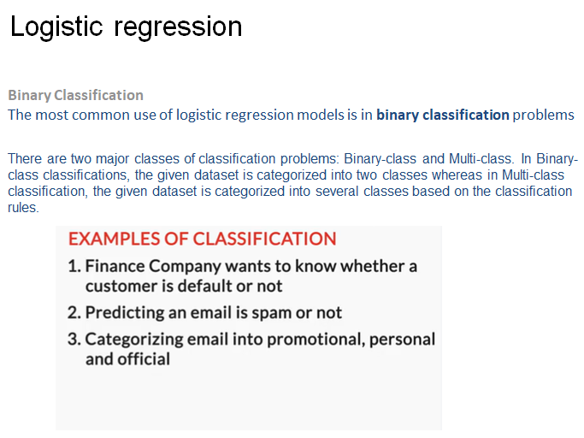

Slide 3
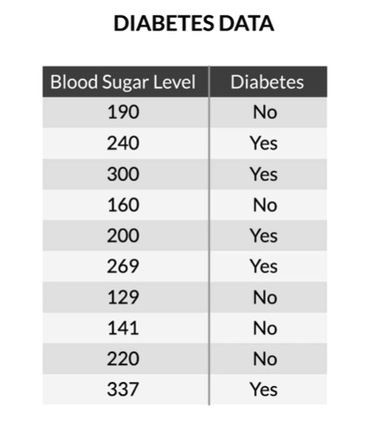
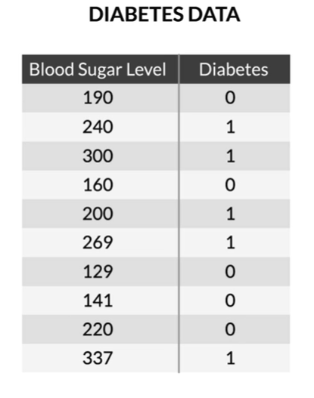

Slide 4
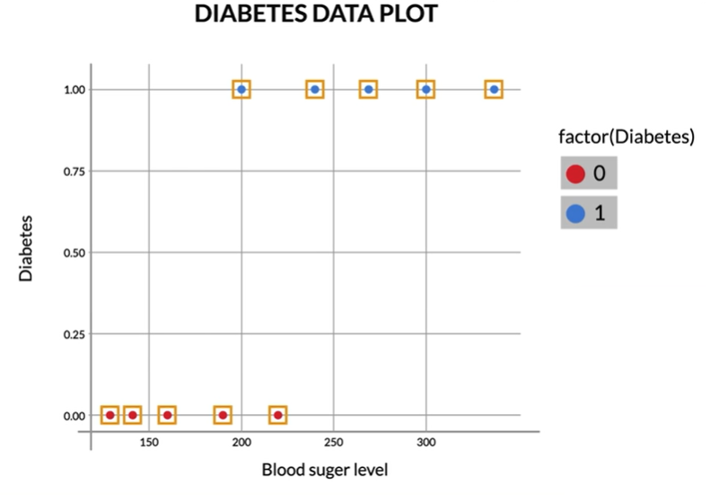

Slide 5
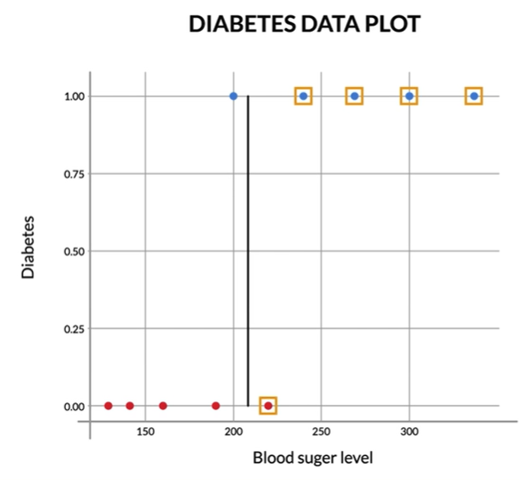
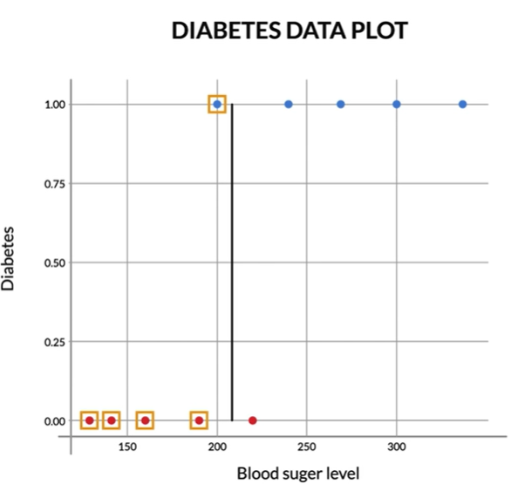

Slide 6
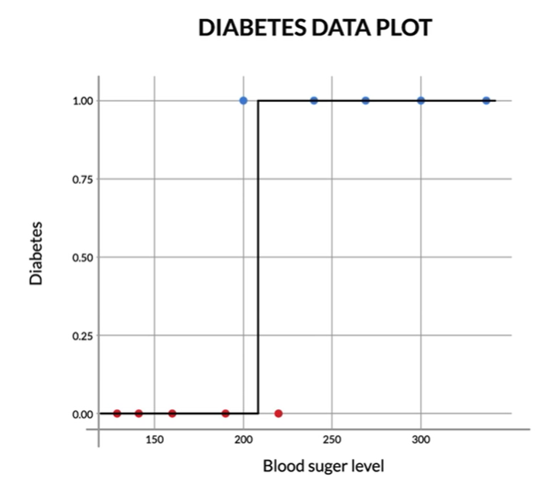

Slide 7
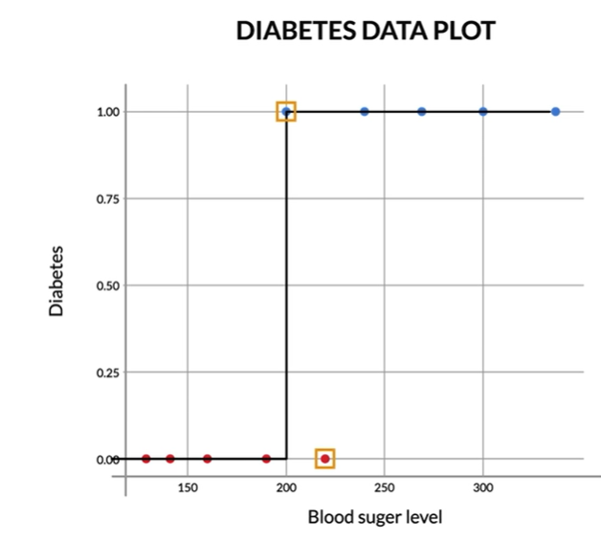

Slide 8
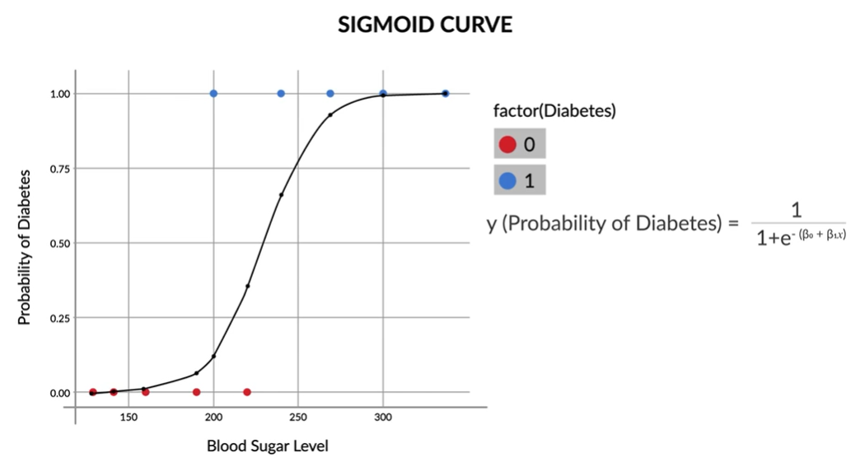
since the sigmoid curve has all the properties you would want — extremely low values in the start, extremely high values in the end, and intermediate values in the middle — it’s a good choice for modelling the value of the probability of diabetes.

Slide 9
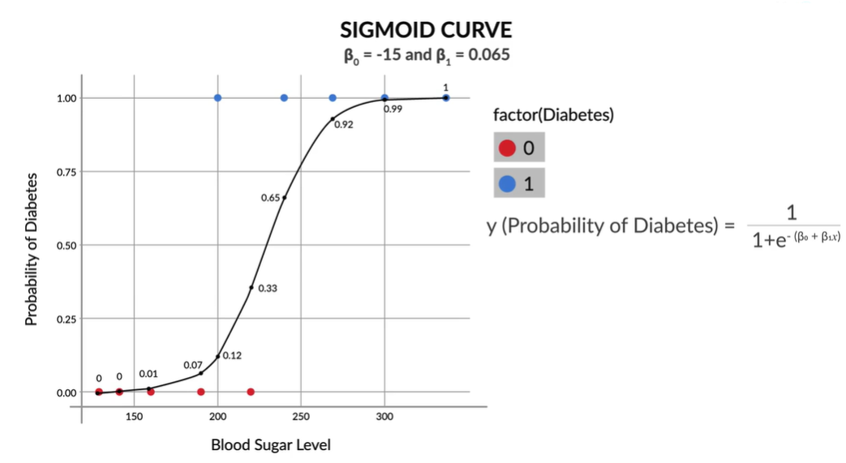
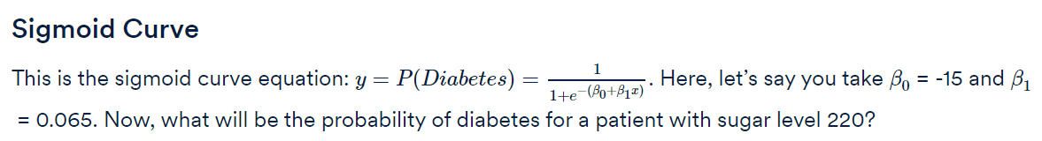

Slide 10
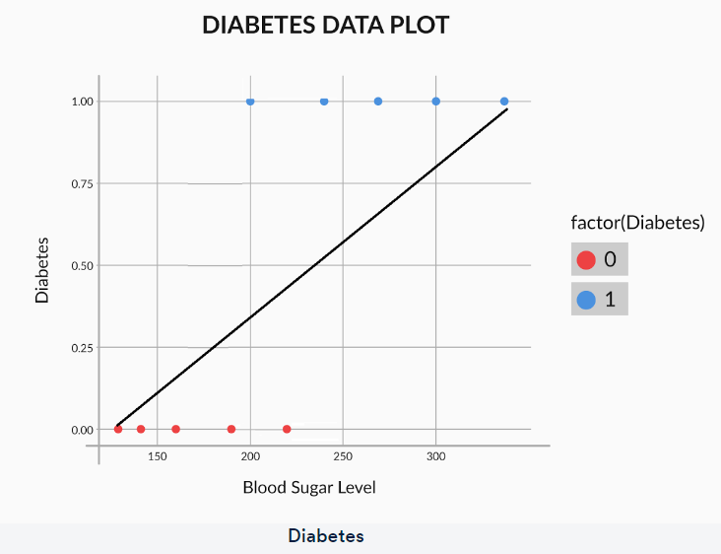
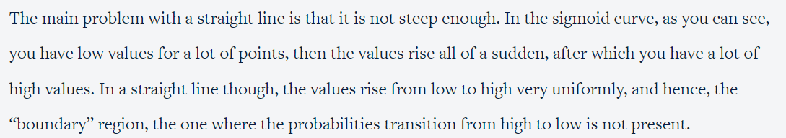

Slide 11
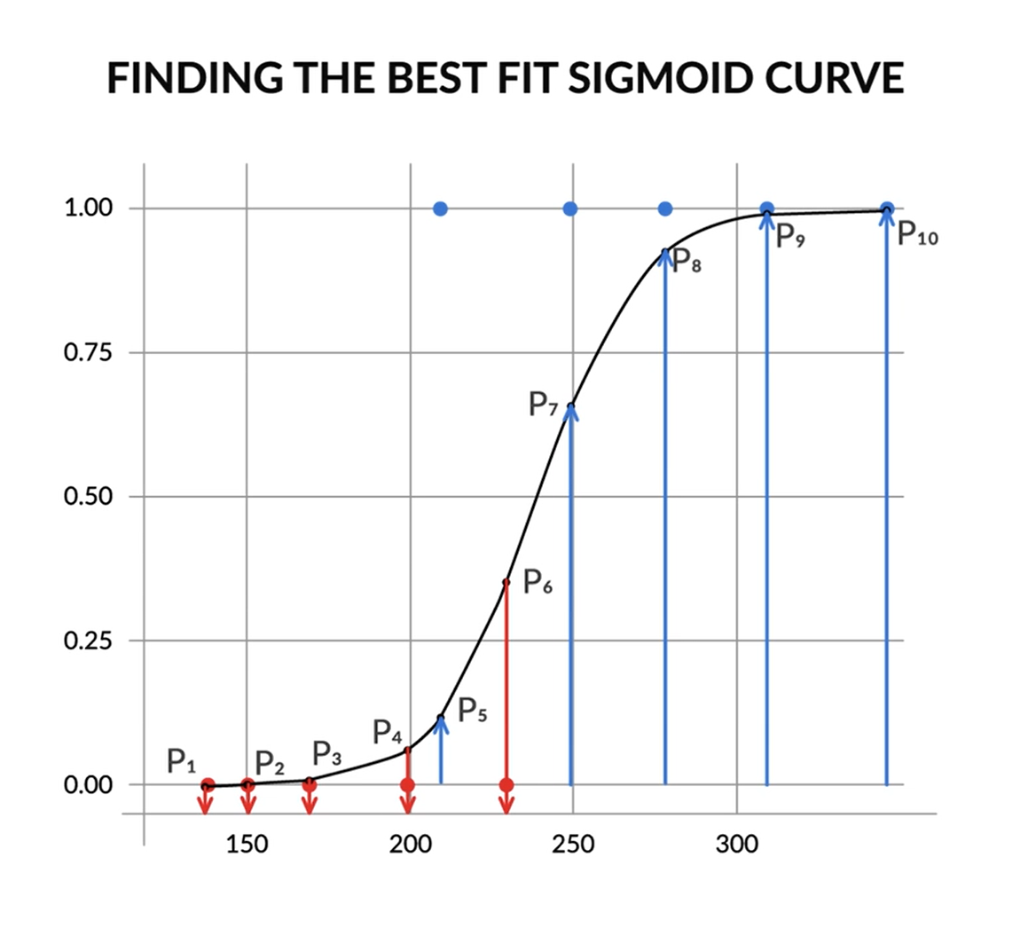
you saw what a sigmoid function is and why it is a good choice for modelling the probability of a class. Now, in this section, you will learn how you can find the best fit sigmoid curve.
So, by varying the values of β0 and β1, you get different sigmoid curves. Now, based on some function that you have to minimise or maximise, you will get the best fit sigmoid curve.

Slide 12
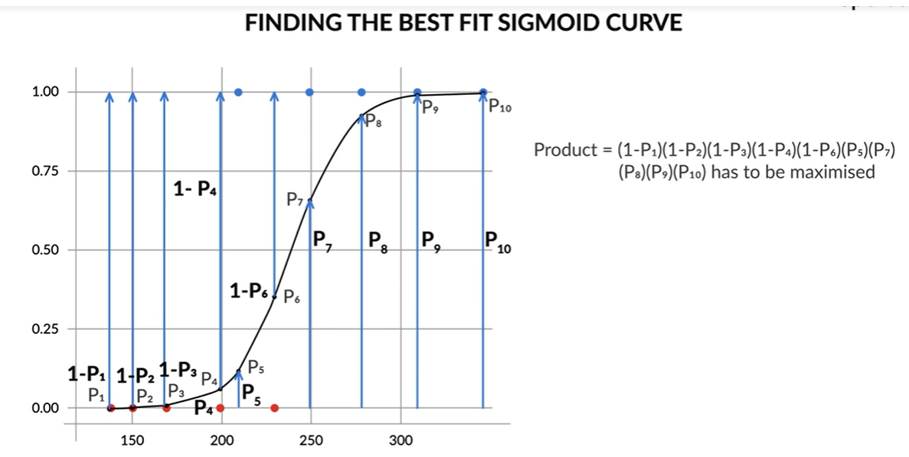
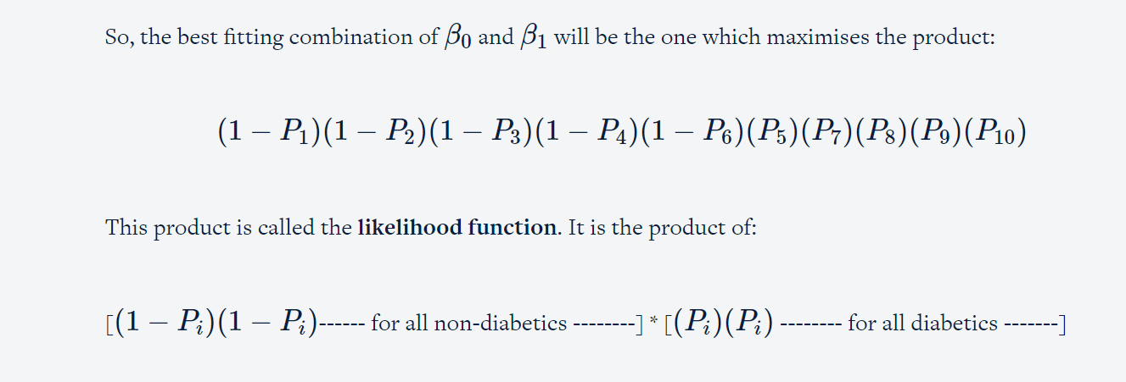

Slide 13
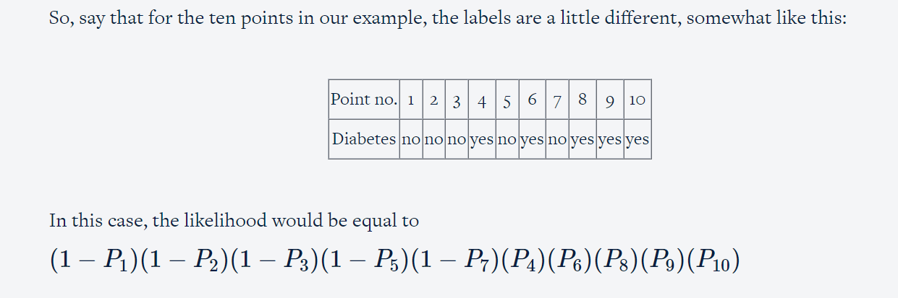

Slide 14
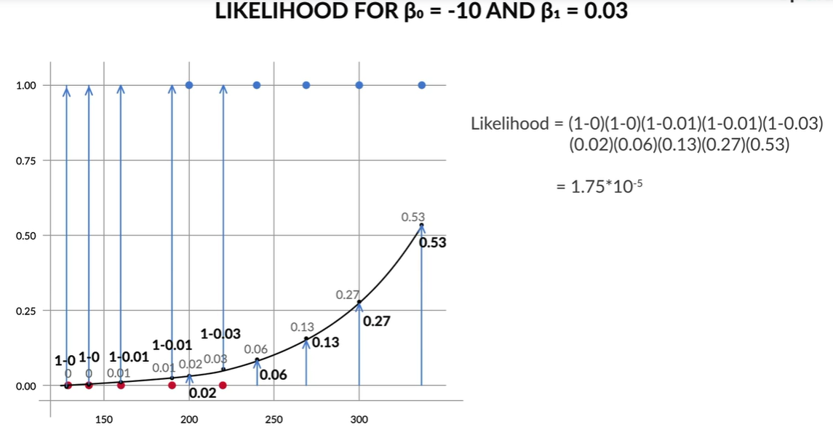

Slide 15
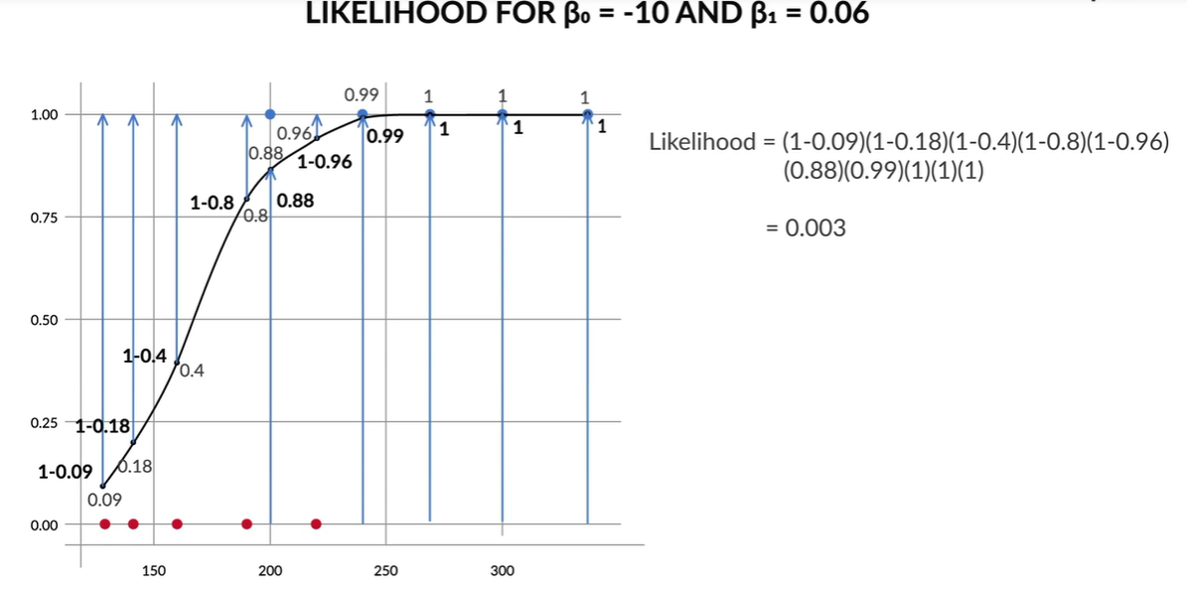

Slide 16
How do you find the optimal values of β0 and β1 such that the likelihood function is maximized?
The optimisation methods used to do that are an optional part of the course (maximum likelihood estimation, or MLE).

Slide 17
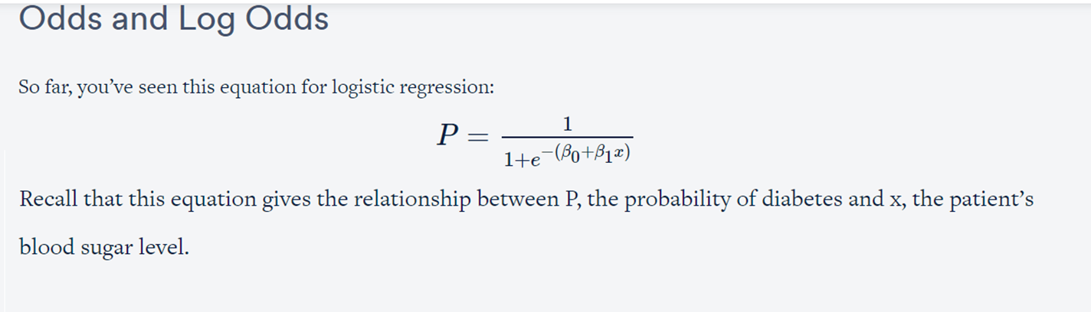
While the equation is correct, it is not very intuitive. In other words, the relationship between P and x is so complex that it is difficult to understand what kind of trend exists between the two.
So, clearly, the relationship between P and x is too complex to see any apparent trends. However, if you convert the equation to a slightly different form, you can achieve a much more intuitive relationship.

Slide 18
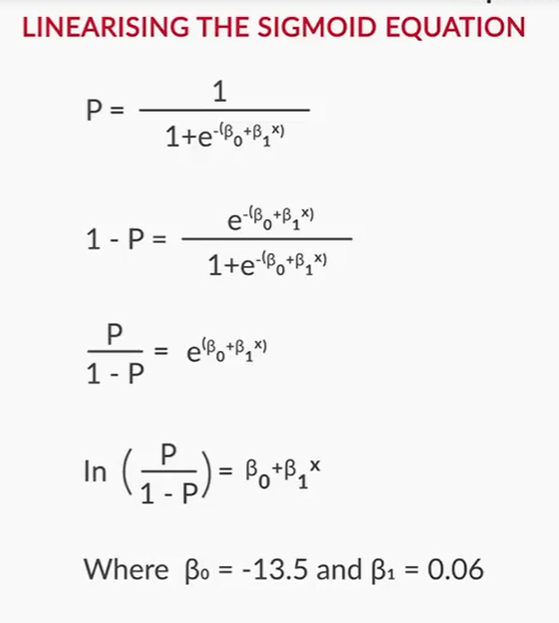

Slide 19
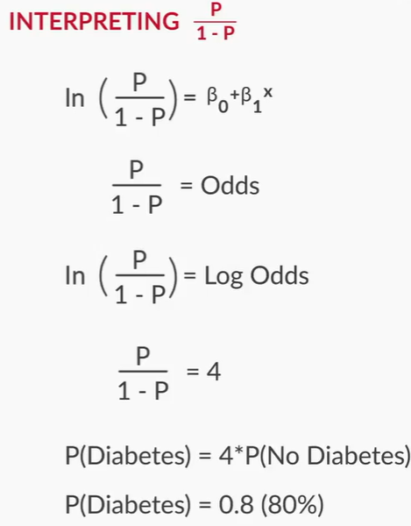
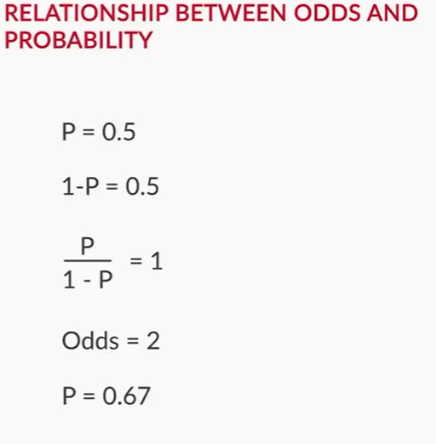

Slide 20
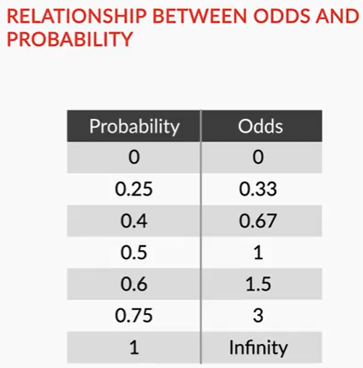

Slide 21
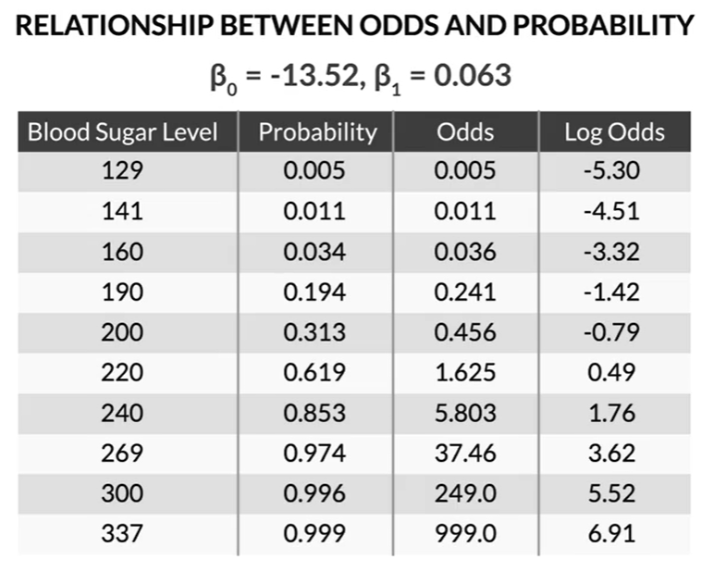

Slide 22
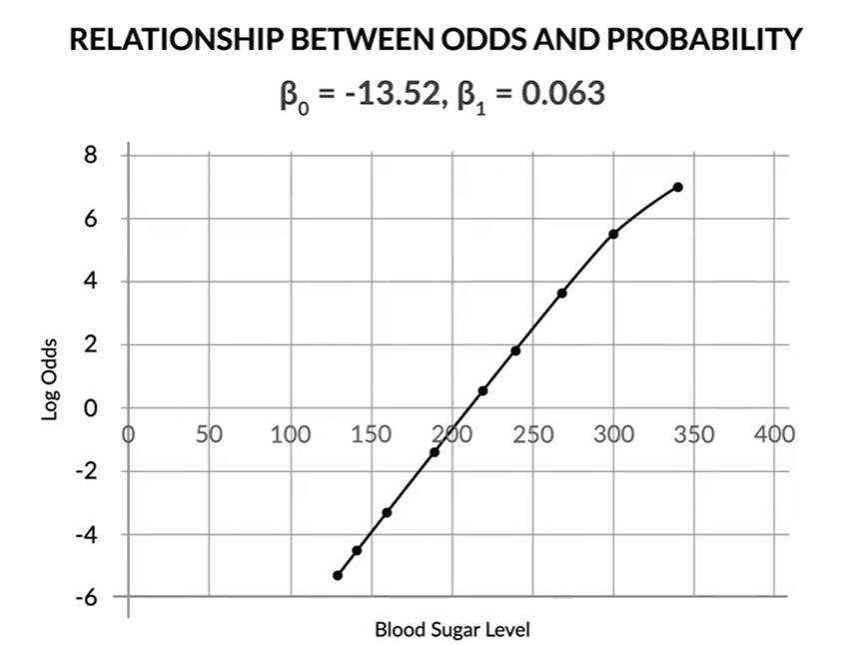

Slide 23
So, the relationship between x and probability is not intuitive, while that between x and odds/log odds is.
This has important implications. Suppose you are discussing sugar levels and the probability they correspond to. While talking about 4 patients with sugar levels of 180, 200, 220 and 240, you will not be able to intuitively understand the relationship between their probabilities (10%, 28%, 58%, 83%).
However, if you are talking about the log odds of these 4 patients, you know that their log odds are in a linearly increasing pattern (-2.18, -0.92, 0.34, 1.60).
It makes more sense to present a logistic regression model’s results in terms of log odds or odds than to talk in terms of probability. This happens especially a lot in industries like finance, banking, etc.

Slide 24
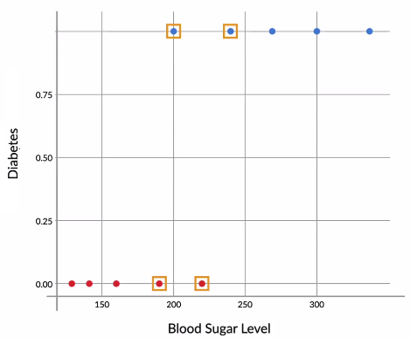
Summary
You first learnt what a binary classification is. Basically, it is a classification problem in which the target variable has only 2 possible values.
You then went through the diabetes example in detail, wherein you tried to predict whether a person has diabetes or not based on that person’s blood sugar level.
You saw why a simple boundary decision approach does not work very well for this example. It would be too risky to decide the class blatantly on the basis of the cutoff because, especially in the middle, the patients could belong to any class — diabetic or non-diabetic.

Slide 25
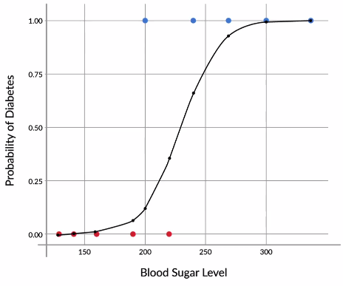

Hence, you learnt that it is better to talk in terms of probability. One such curve which can model the probability of diabetes very well is the sigmoid curve.

Slide 26
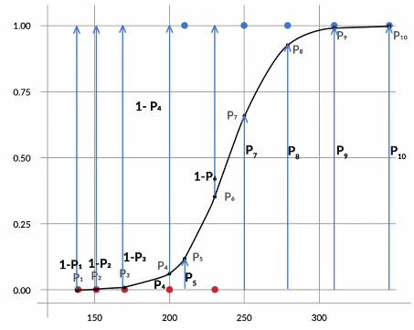
Then, you learnt that in order to find the best-fit sigmoid curve, you need to vary β0 and β1 until you get the combination of beta values that maximizes the likelihood. For the diabetes example, the likelihood is given by the expression:
Likelihood=(1−P1)(1−P2)(1−P3)(1−P4)(P5)(1−P6)(P7)(P8)(P9)(P10)

Slide 27

Likelihood=(1−P1)(1−P2)(1−P3)(1−P4)(P5)(1−P6)(P7)(P8)(P9)(P10)
It is the product of:
[(1−Pi)(1−Pi) ------ for all non-diabetics --------] * [(Pi)(Pi) -------- for all diabetics -------]
This process, where you vary the betas until you find the best fit curve for the probability of diabetes, is called logistic regression.
After this, you saw a simpler way of interpreting the equation for logistic regression. You saw that the following linearized equation is much easier to interpret:

Slide 28
The left-hand side of this equation is what is called log odds. Basically, the odds of having diabetes (P/1-P), indicate how much likelier a person is to have diabetes than to not have it. For example, a person for whom the odds of having diabetes are equal to 3, is 3 times more likely to have diabetes than to not have it.
In other words, P(Diabetes) = 3 * P(No diabetes).
You also saw how odds vary with variation in x. Basically, with every linear increase in x, the increase in odds is multiplicative. For example, in the diabetes case, after every increase of 11.5 in the value of x, the odds are approximately doubled, i.e. they increase by a multiplicative factor of about 2.

